Slide 1

Frequency Domain Adversarial Training for Robust Volumetric Medical Segmentation
Asif Hanif, Muzammal Naseer, Salman Khan,
Mubarak Shah, Fahad Shahbaz Khan
Mohamed Bin Zayed University of Artificial Intelligence (MBZUAI), UAE
University of Central Florida (UCF), USA
Linköping University, Sweden

Slide 2
Introduction
Semantic segmentation of organs, anatomical structures, or anomalies in medical images (e.g. CT or MRI scans) remains one of the fundamental tasks in medical image analysis.
Deep learning and volumetric medical image segmentation
Adversarial vulnerability of volumetric medical image segmentation
Adversarial robustness of medical image models
Understanding the vulnerability and robustness of medical image models
Notes:
1- Semantic segmentation in medical images is one of the fundamental tasks in medical image analysis.
2- In recent years deep learning has improved performance in many areas of research. Volumetric medical image segmentation has also benefited from recent advances in deep learning.
3- Despite this progress, the real-world deployment of medical image models is not straightforward due to the vulnerabilities towards adversarial attacks.
4- Ensuring the adversarial robustness of the models involved in safety-critical applications such as, medical imaging and healthcare is of paramount importance because a misdiagnosis or incorrect decision can result in life-threatening implications.
5- The adversarial robustness of the medical imaging models is still an open and under-explored area. Furthermore, most adversarial attacks and defenses have been designed for 2D natural images and little effort has been made to secure volumetric (3D) medical data.

Slide 3
Contributions
Volumetric Adversarial Frequency Attack (VAFA)
Volumetric Adversarial Frequency Training (VAFT)
Notes:
We propose an approach with a min-max objective for adversarial training of volumetric MIS model in the frequency domain. In particular, we introduce a volumetric adversarial frequency attack (VAFA) for volumetric medical data. Further, we introduce a volumetric adversarial frequency-domain training (VAFT) based on a frequency consistency loss to robustify the model against attack..
We conduct experiments with two different hybrid CNN-transformers based volumetric medical segmentation methods for multi-organ segmentation.

Slide 4
Voxel-domain Attacks vs. Frequency-domain Attacks
Voxel-domain Attacks: Directly perturb input space
Frequency-domain Attacks: Preturb the frequency-domain representation of an image e.g. DCT
Notes:
Voxel domain attacks operate in the input space of the images whereas frequency-domain attacks operate in the frequency-domain representation of the images, for instance DCT.

Slide 5
Method
Volumetric Adversarial Frequency domain Attack (VAFA)
Volumetric Adversarial Frequency domain Training (VAFT)

Slide 6
Volumetric Adversarial Frequency Domain Attack (VAFA)

Slide 7
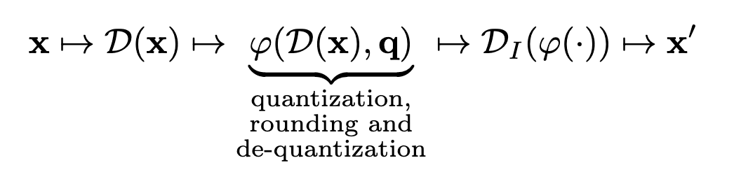
Volumetric Adversarial Frequency Domain Attack (VAFA)
Notes:
Our attack partitions the volumetric image into small 3D patches. After taking DCT of each patch, it performs three oprations which are quantization, differentiable rounding and de-quantization. These three operations result in some DCT coefficients being set to zero. In this process, a quantization table “q” is used which is learned via iterative optimization. To get back voxel-domain image, we take inverse DCT of the perturbed frequency-domain data.

Slide 8
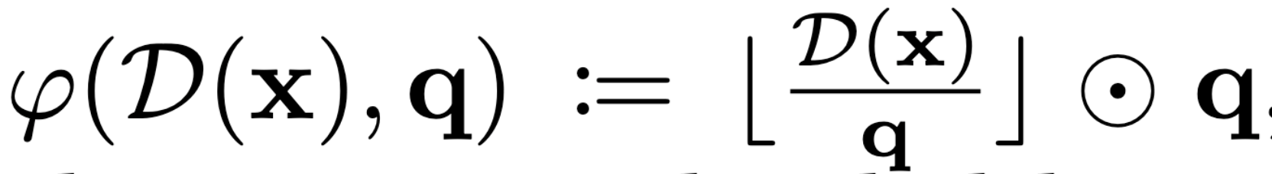
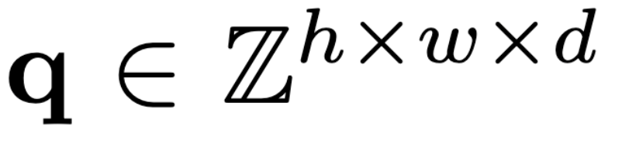
Volumetric Adversarial Frequency Domain Attack (VAFA)
Notes:
Quantization, differentible rounding and de-quantization of DCT coefficients

Slide 9
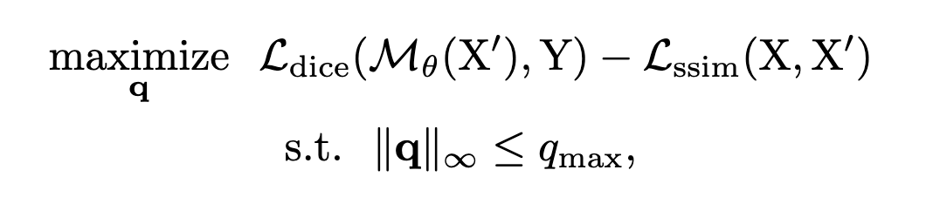
Volumetric Adversarial Frequency Domain Attack (VAFA)
Notes:
We learn quatization table q while maximizing the Dice loss and minimizing the SSIM loss between clean and adversarial image. To restrict the perturbation in frequency-domain, we constrain the value of quantization table with a bound Q_max

Slide 10
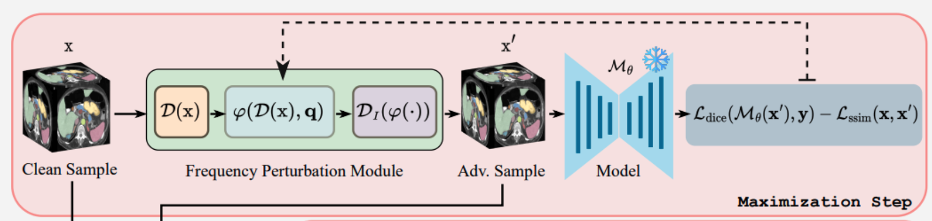
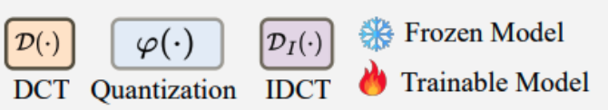
Volumetric Adversarial Frequency Domain Attack (VAFA)
Notes:
This diagram gives overall view of our proposed attack.

Slide 11
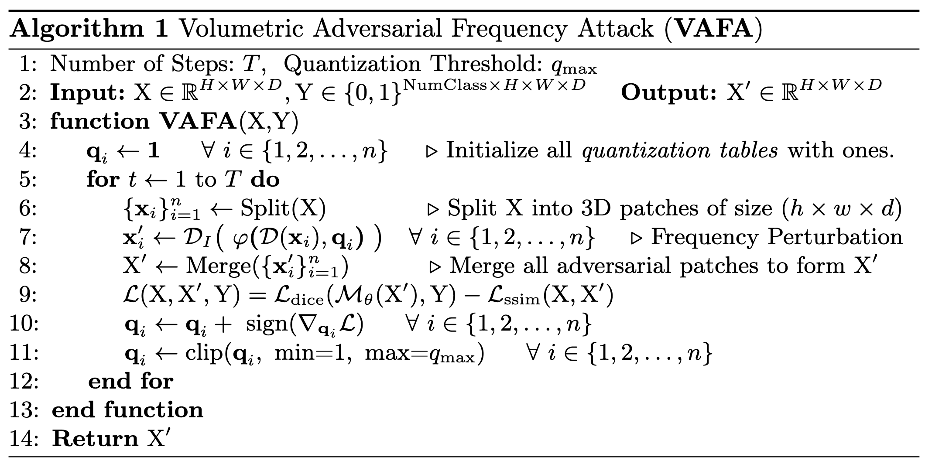
Volumetric Adversarial Frequency Domain Attack (VAFA)
Notes:
VAFA algorithm

Slide 12
Volumetric Adversarial Frequency Domain Training (VAFT)

Slide 13
Volumetric Adversarial Frequency Domain Training (VAFT)
Notes:
In our frequency-domain adversarial training, we update the model weights while optimizing the three loss terms: first term is the Dice loss on model prediction with clean image, second term is the Dice loss on model prediction with adversarial image. The thrid term is frequency consistency loss which tries to keep the frequency-domain representation of model predictions on clean and adversarial images.

Slide 14
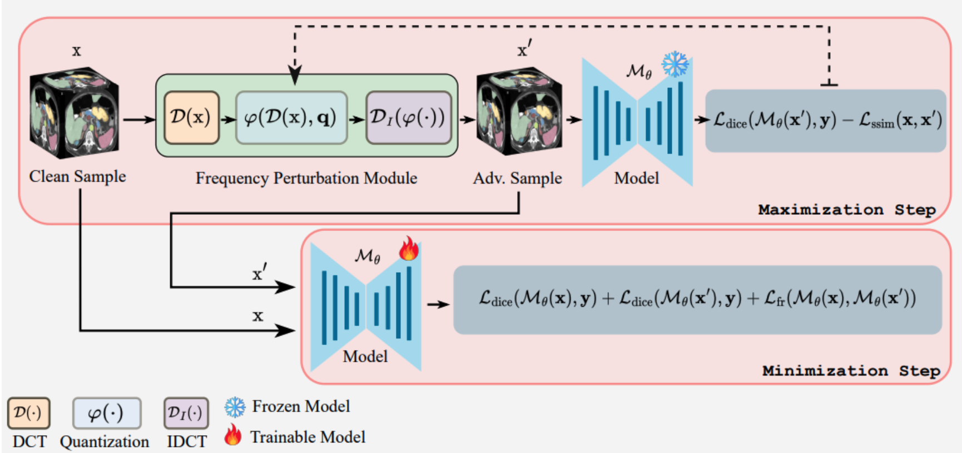
Volumetric Adversarial Frequency Domain Training (VAFT)
Notes:
This diagram gives overall view of adversarial attack and training.

Slide 15
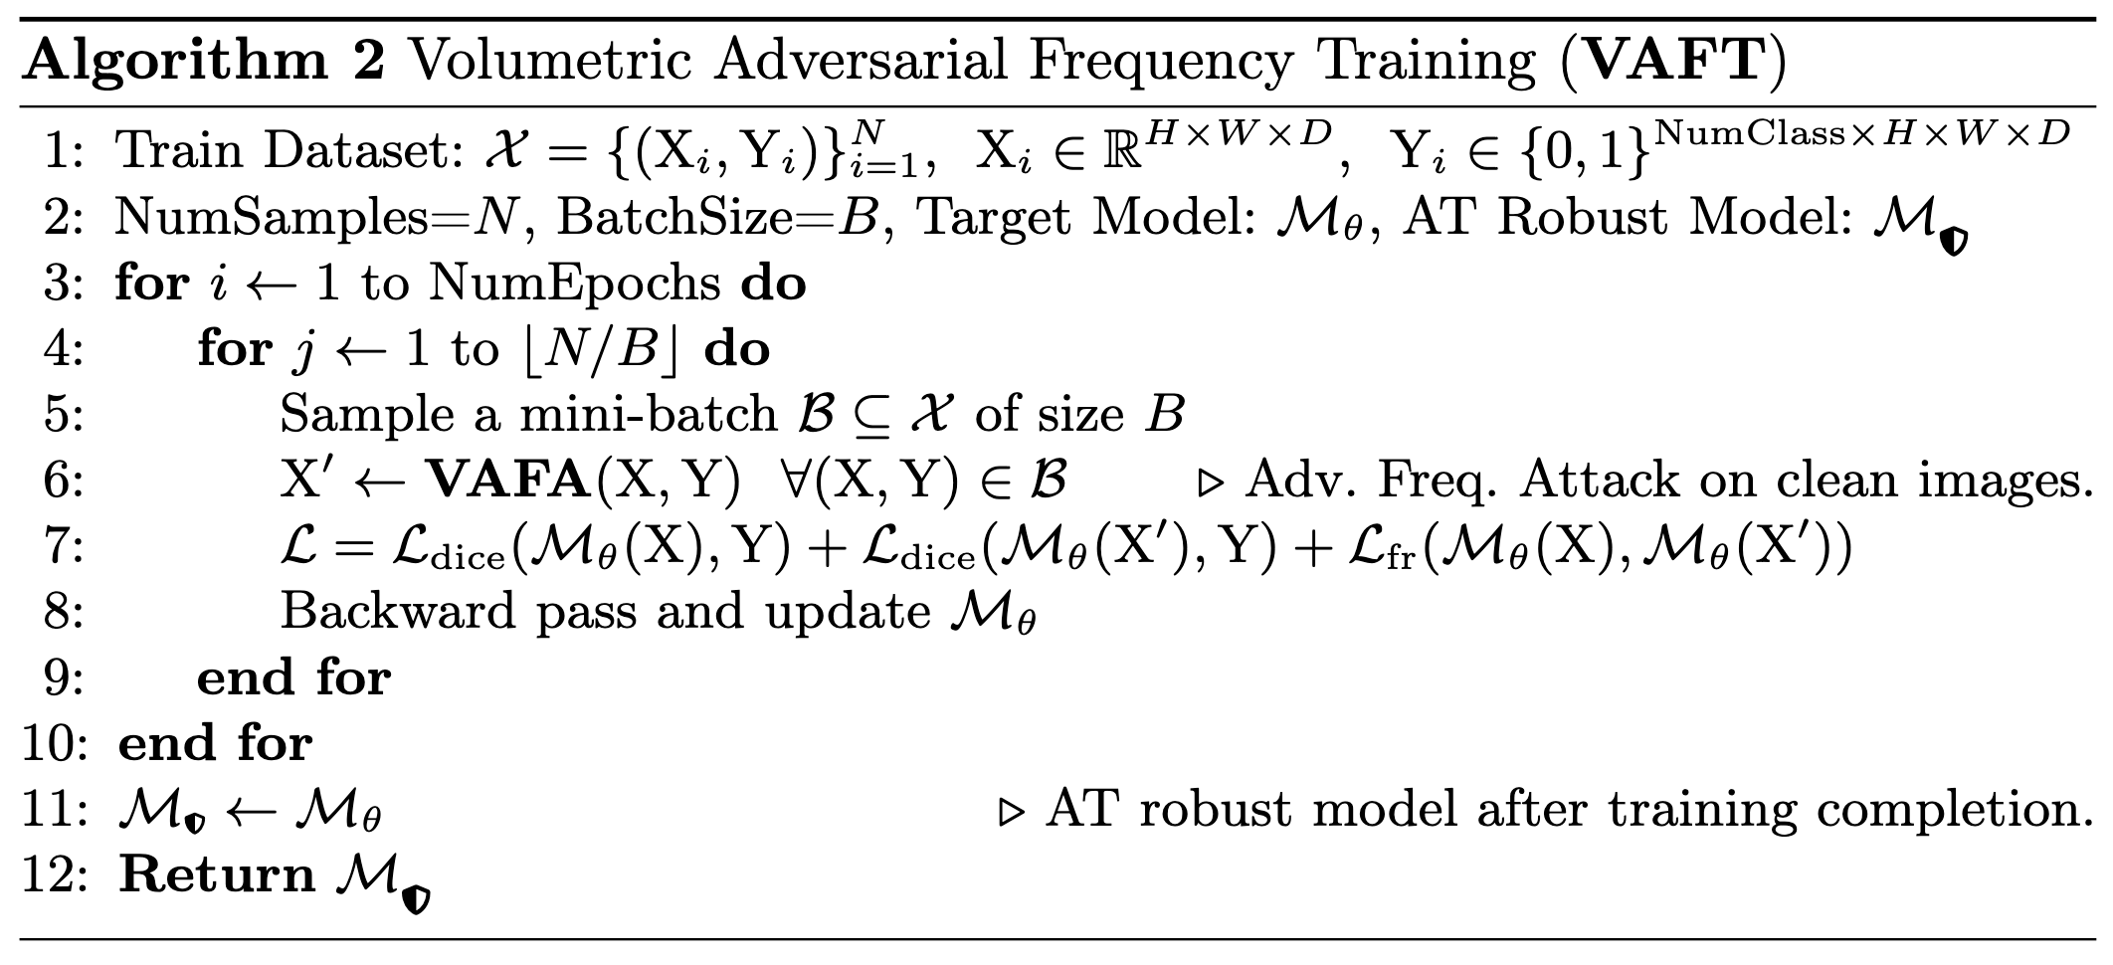
Volumetric Adversarial Frequency Domain Training (VAFT)
Notes:
VAFT algorithm

Slide 16
Results
Segmentation Models: UNETR and UNETR++
Datasets: Synapse and ACDC
Baseline Attacks: PGD, FGSM, BIM, GN
Evaluation Metrics: Dice Score, HD95 Distance, LPIPS
Programming Framework: Pytorch
Notes:
We show our results using two segmentation models (UNETR and UNETR++) and two datasets (Synapse and ACDC). We chose PGD, FGSM, BIM and Gaussian Noise as baseline attacks. For evaluation metrics, we use Dice Score, HD95 distance and LPIPS. We implement baseline methods and our own method using Pytorch framework.

Slide 17
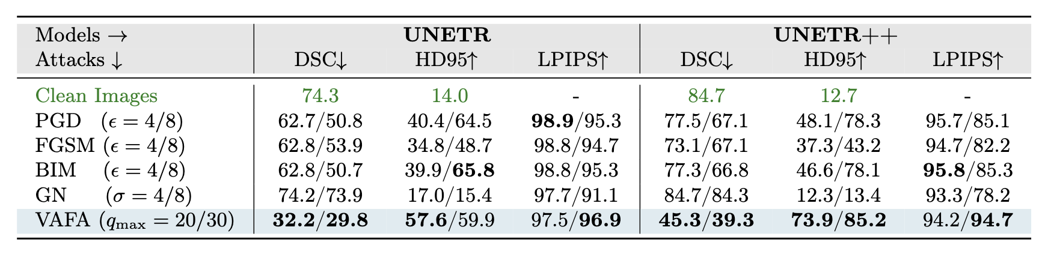
Volumetric Adversarial Frequency Domain Attack (VAFA)
Notes:
This table shows that our attack VAFA outperforms other baseline methods in terms Dice Score and LPIPS.

Slide 18
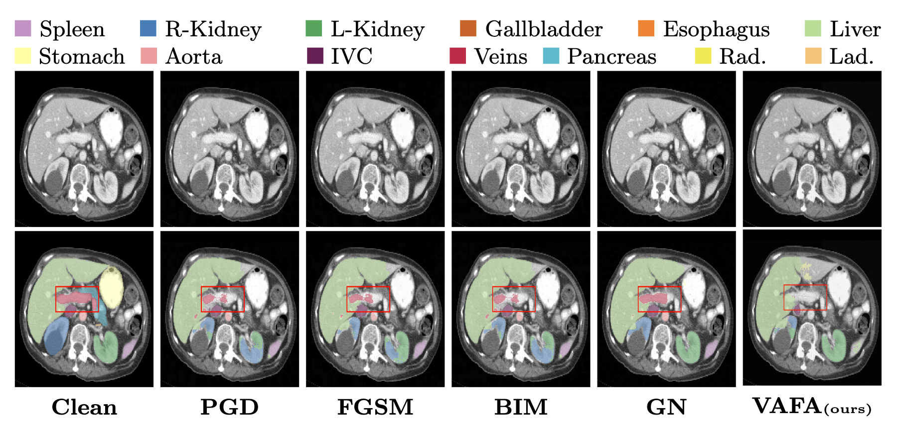
Volumetric Adversarial Frequency Domain Attack (VAFA)
Notes:
Here is an example of qualitative result obtained from baseline methods and our attack.

Slide 19
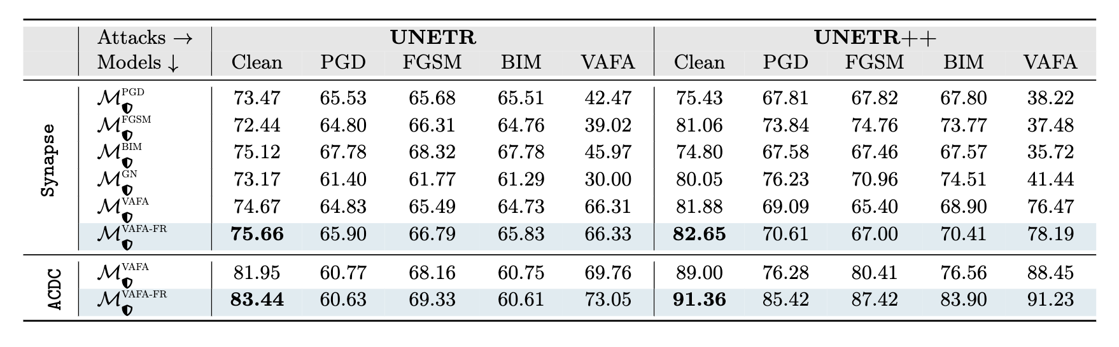
Volumetric Adversarial Frequency Domain Training (VAFT)
Notes:
This table shows the performance of models against different attacks after adversarial training. Our robust model shows resilience against attacks, including our own.

Slide 20
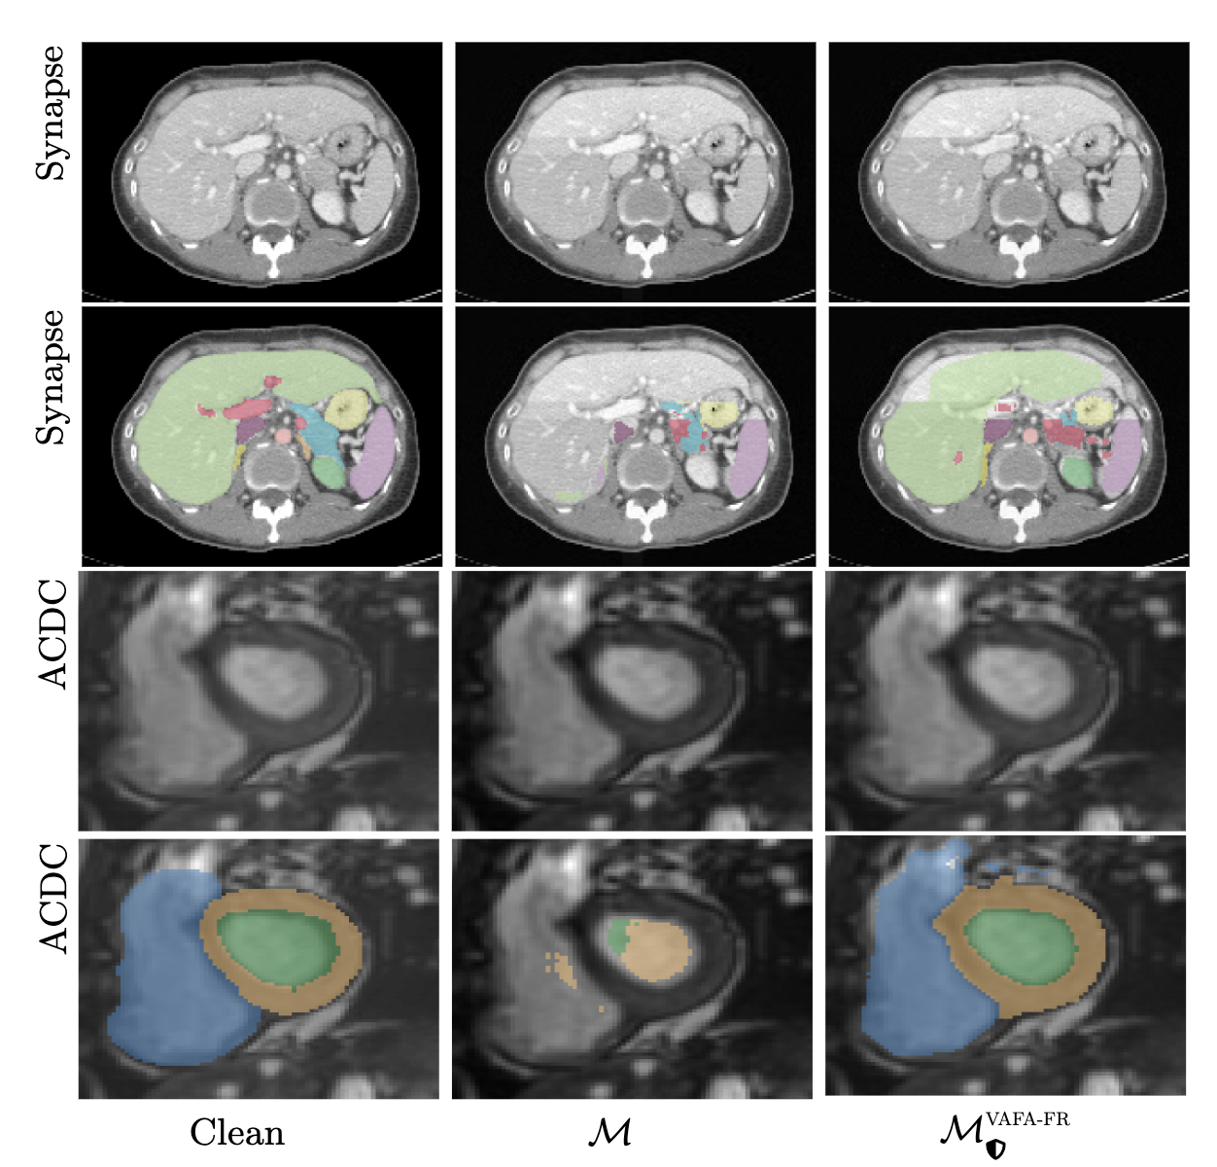
Volumetric Adversarial Frequency Domain Training (VAFT)
Notes:
2nd and 3rd column of this figure shows model prediction before and after adversarial training.

Slide 21
Github Repository
https://github.com/asif-hanif/vafa

Slide 22
Thank you !

Slide 23
VAFA – Ablation Study
Impact of quantization threshold
Impact of steps
Impact of patch size

Slide 24
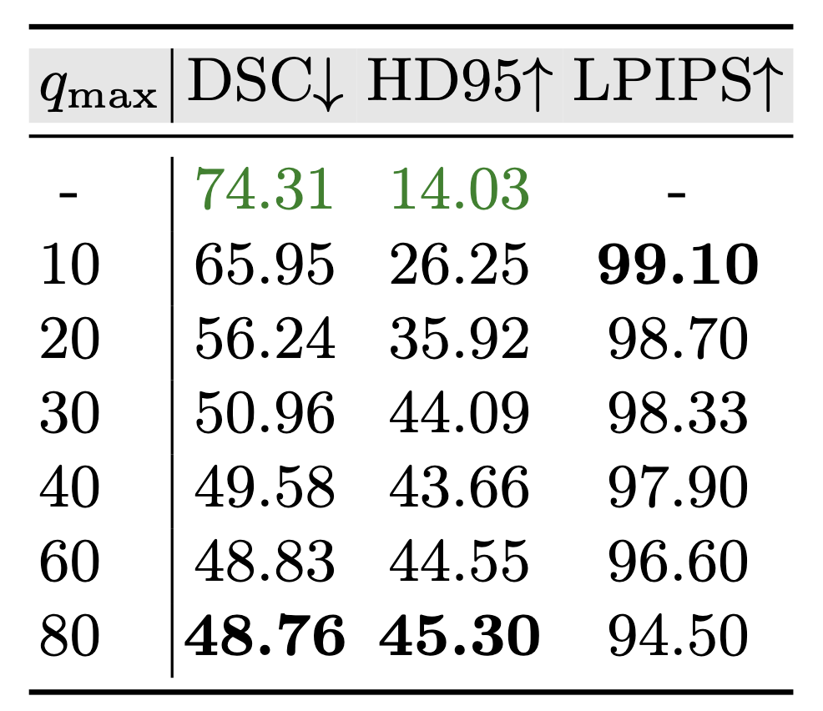
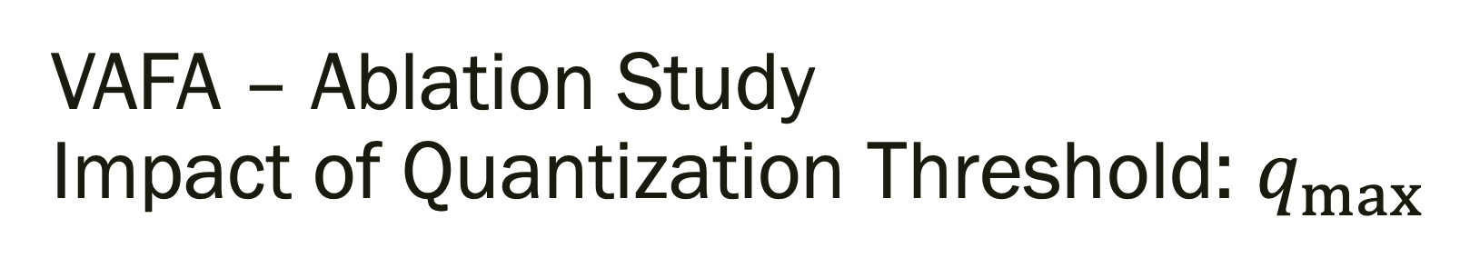
VAFA – Ablation Study Impact of Quantization Threshold: $q_{max}$

Slide 25
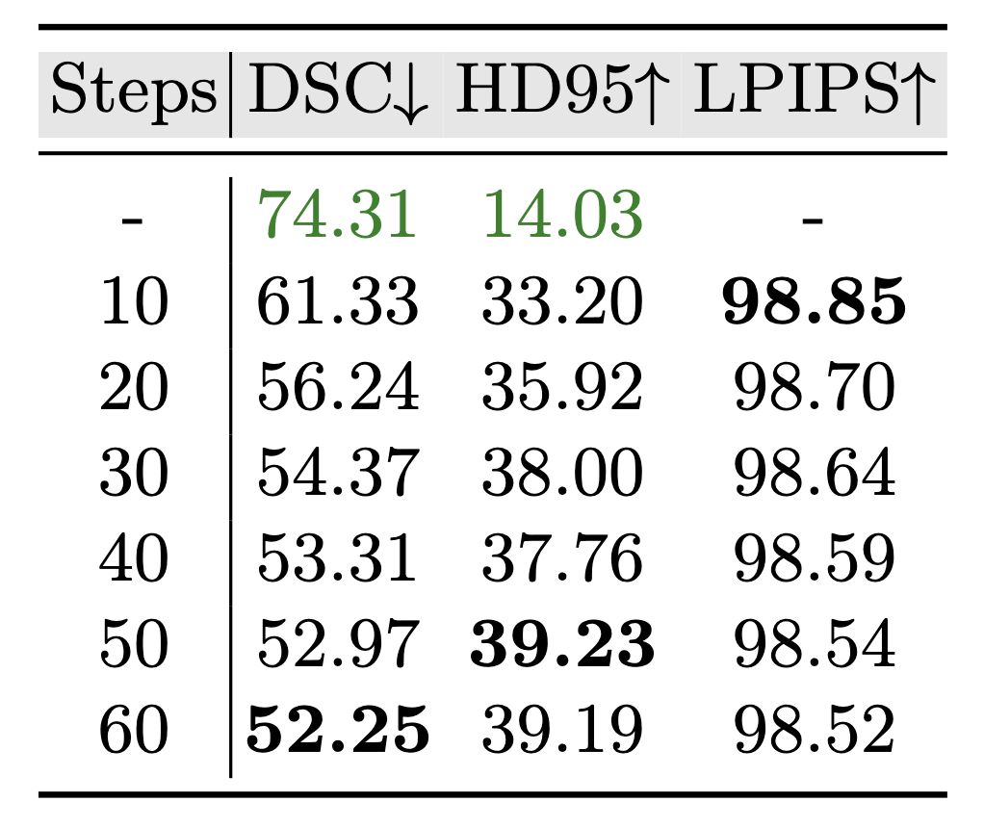
VAFA – Ablation Study Impact of Steps

Slide 26
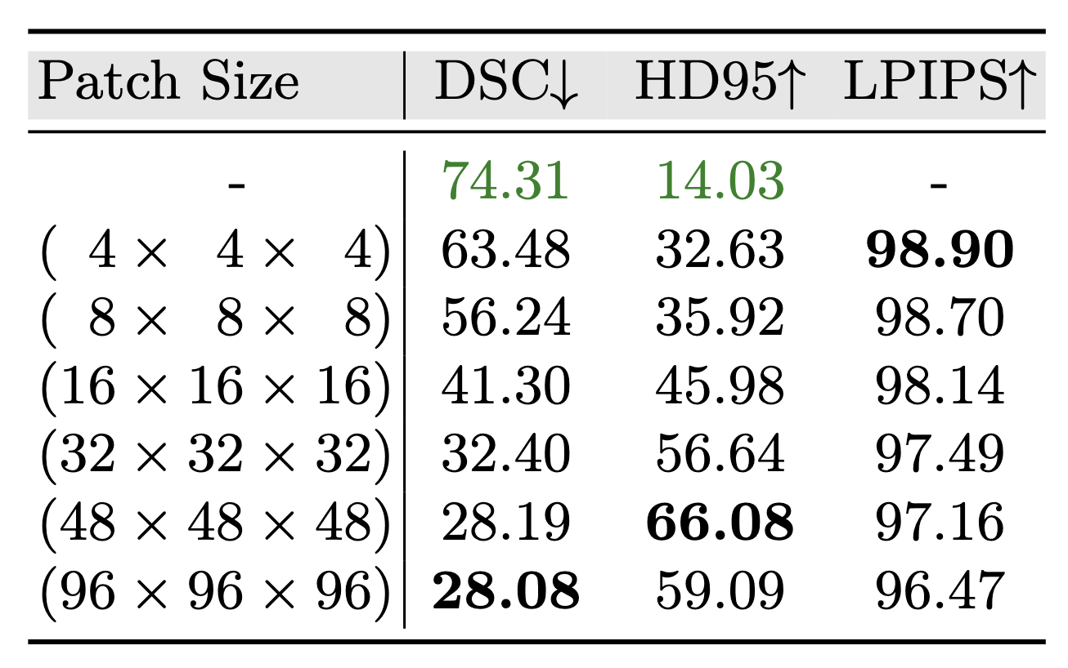
VAFA – Ablation Study Impact of Patch-Size

